Slide 1






Building PKN based multifracturing model
P. Kuśmierczyk^{1,2}, G. Mishuris¹,
¹IMAPS, Aberystwyth University, Ceredigion SY23 3BZ, Wales, U.K.
²EUROTECH Sp. z o.o., ul. Wojska Polskiego 3, 39-300 Mielec, Poland
This research has been supported by FP7 PEOPLE IAPP Project HYDROFRAC under number 251475.

Slide 2
Plan of the talk
Review of previous published work on PKN model
Testing and further improvements to our model
How to combine single fractures in to multifracturing?

Slide 3
Review of previous work on PKN model (FD approach)

Slide 4
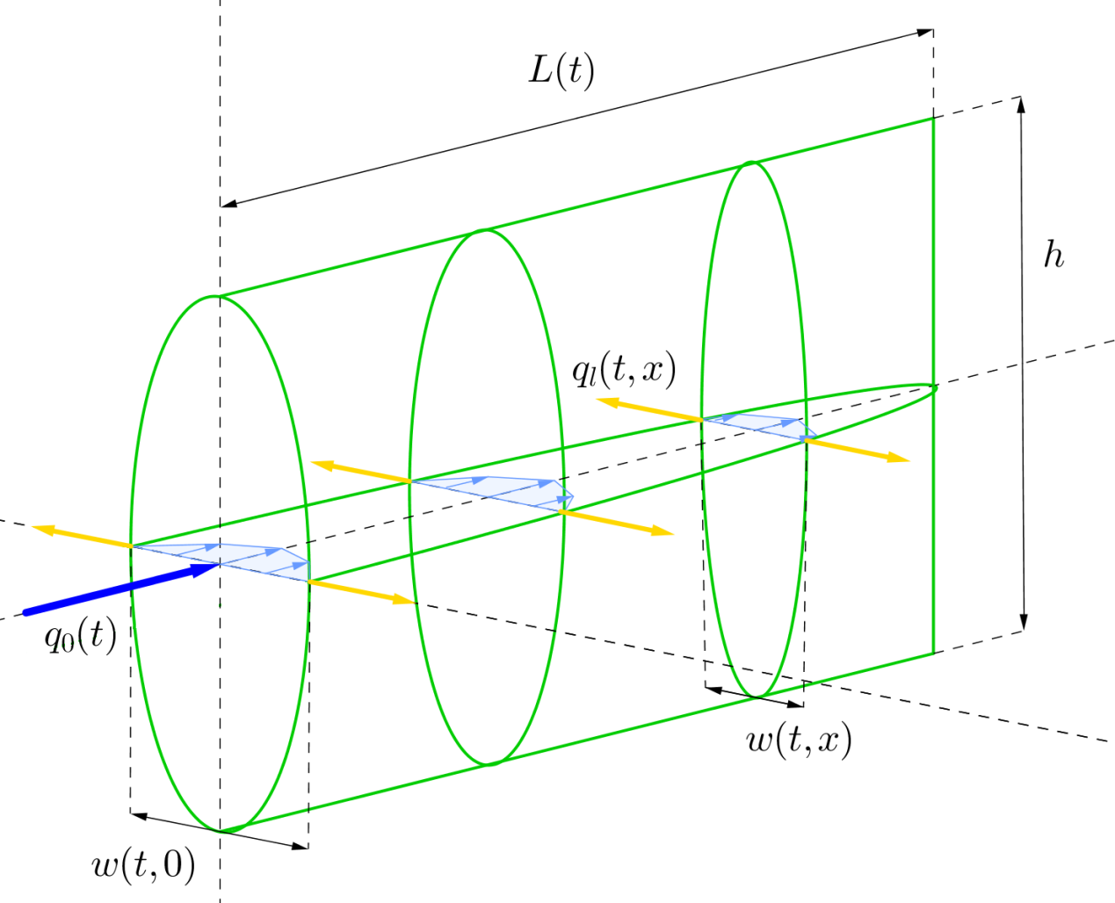
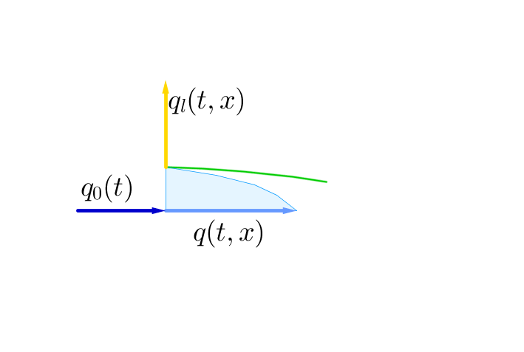
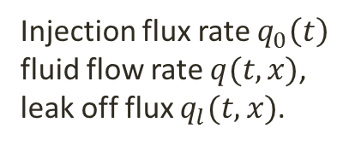
PKN model geometry
Named after Perkins, Kern and Nordgren
fracture length
constant fracture
height
Injection flux rate $q_{0}\left(t\right)$
fluid flow rate $q(t,x)$,
leak off flux $q_{l}(t,x)$.
crack width

Slide 5
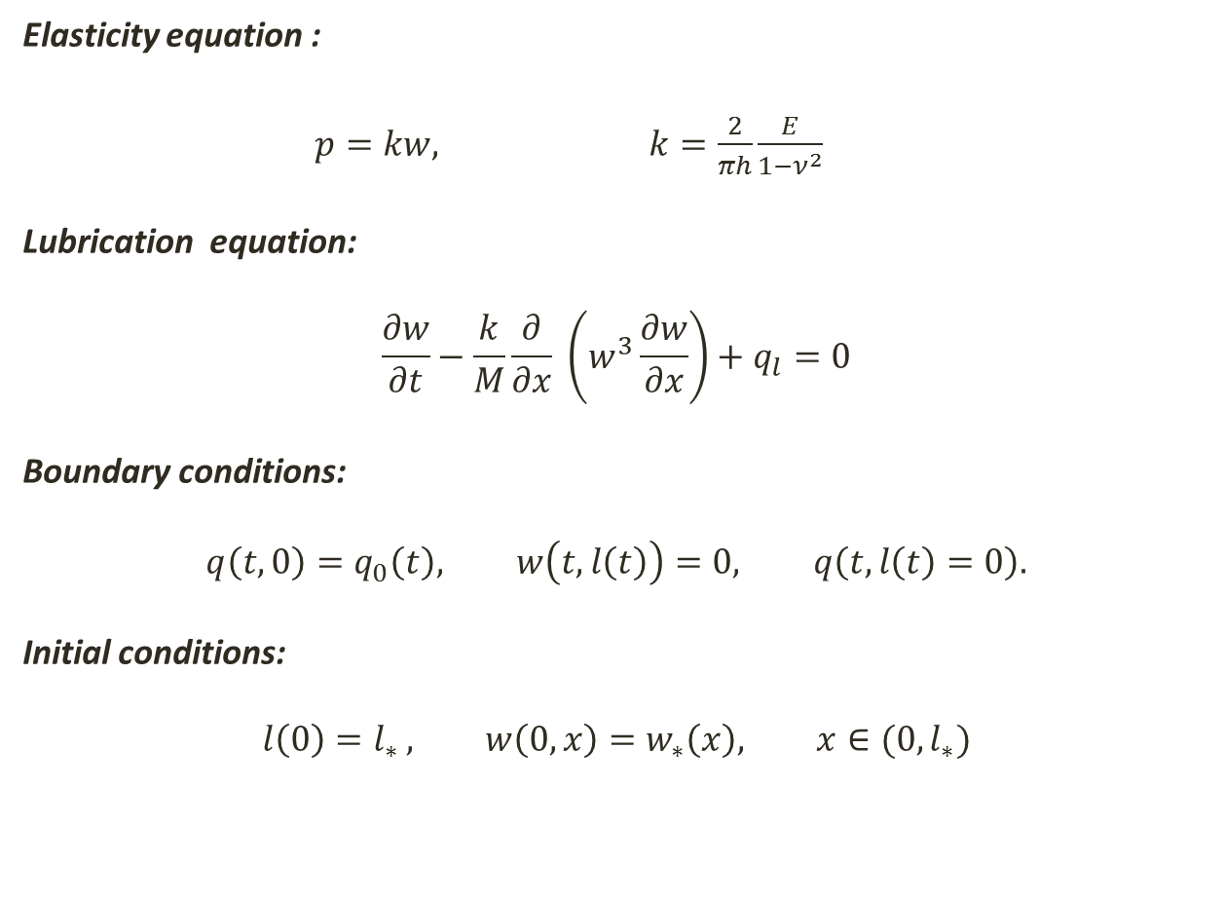
PKN problem formulation
Elasticity equation :
$p=kw,$ $k=\frac{2}{πh}\frac{E}{1−ν^{2}}$
Lubrication equation:
$$\frac{∂w}{∂t}−\frac{k}{M}\frac{∂}{∂x} \left(w^{3}\frac{∂w}{∂x}\right)+q_{l}=0$$
Boundary conditions:
$$q\left(t,0\right)=q_{0}\left(t\right), w\left(t,l\left(t\right)\right)=0, q\left(t,l\left(t\right)=0\right).$$
Initial conditions:
$$l\left(0\right)=l_{∗ }, w\left(0,x\right)=w_{∗}\left(x\right), x∈(0,l_{∗})$$
net pressure
nonlinear Neumann type condition
Moving boundary (crack tip)
So in theory we can start form any arbitrary shape

Slide 6
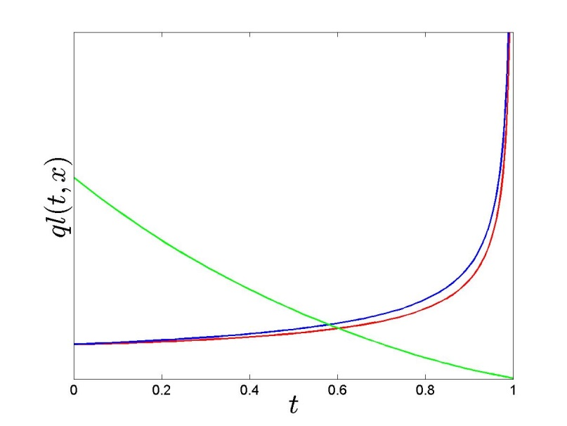
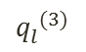
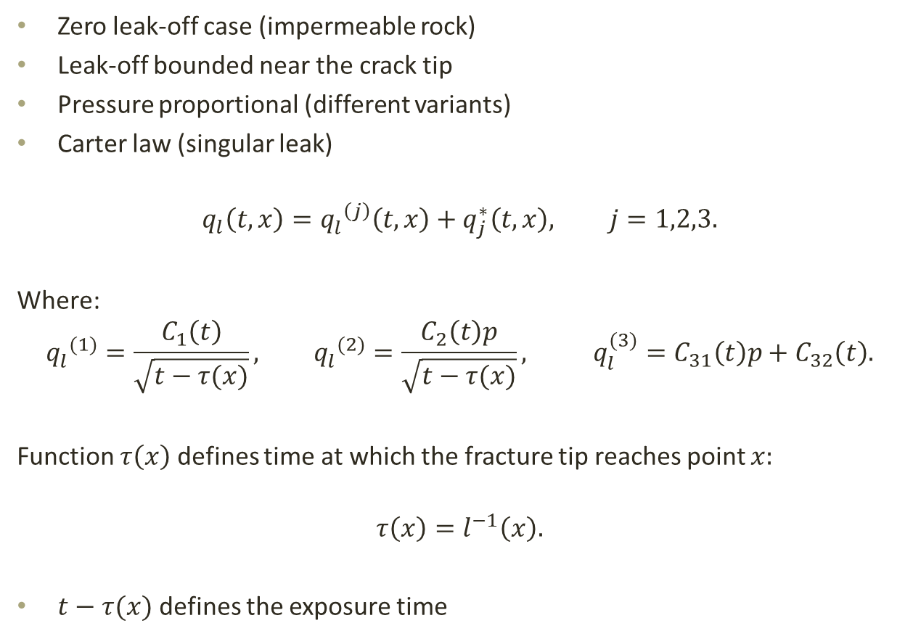
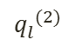
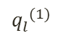
Considered leak-off regimes
Zero leak-off case (impermeable rock)
Leak-off bounded near the crack tip
Pressure proportional (different variants)
Carter law (singular leak)
$$q_{l}\left(t,x\right)={q_{l}^{}}^{\left(j\right)}\left(t,x\right)+q_{j}^{∗}\left(t,x\right), j=1,2,3.$$
Where:
$${q_{l}^{}}^{(1)}=\frac{C_{1}\left(t\right)}{\sqrt{t−τ(x)}}, {q_{l}^{}}^{(2)}=\frac{C_{2}\left(t\right)p}{\sqrt{t−τ(x)}}, q_{l}^{(3)}=C_{31}\left(t\right)p+C_{32}\left(t\right).$$
Function $τ\left(x\right)$ defines time at which the fracture tip reaches point $x:$
$$τ\left(x\right)=l^{−1}\left(x\right).$$
$t−τ(x)$ defines the exposure time
$${q_{l}^{}}^{(3)}$$
$${q_{l}^{}}^{(2)}$$
$${q_{l}^{}}^{(1)}$$

Slide 7
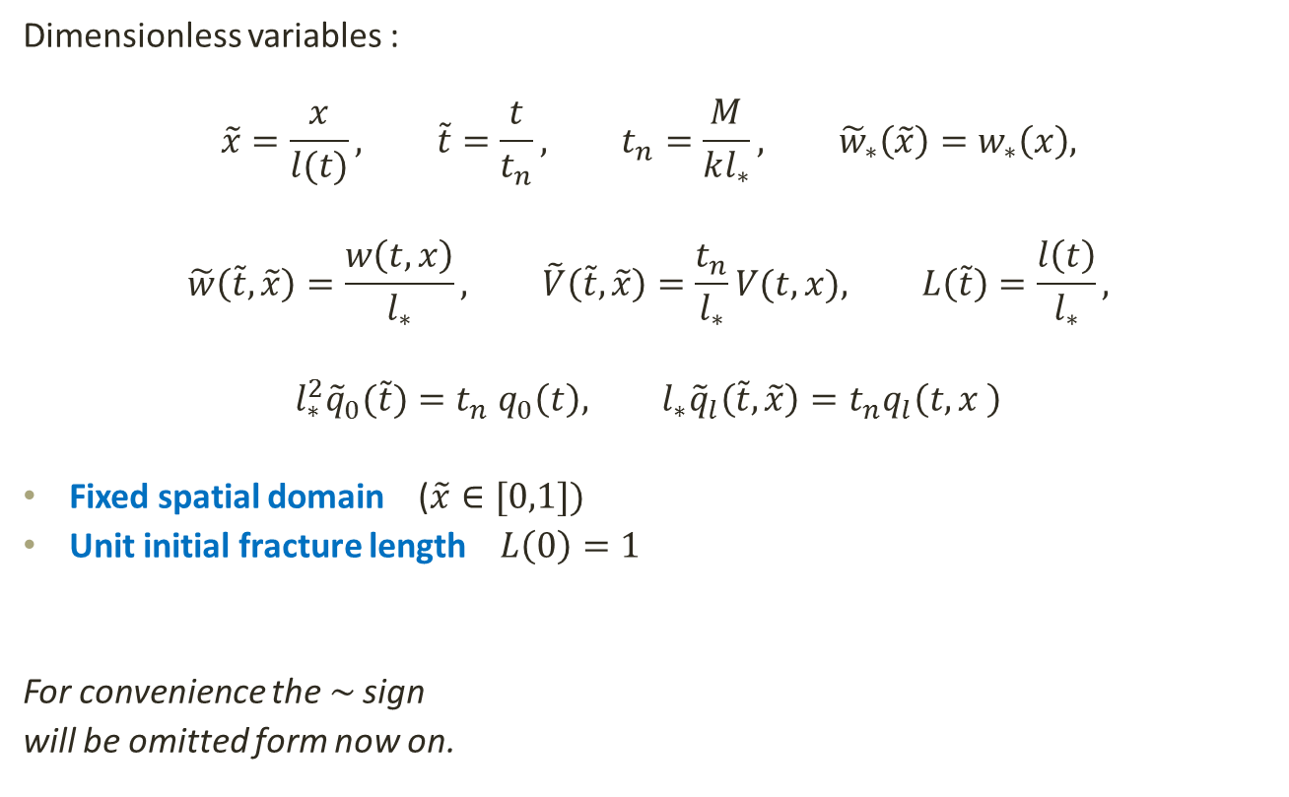
Normalization
Dimensionless variables :
$$\tilde{x}=\frac{x}{l(t)}, \tilde{t}=\frac{t}{t_{n}}, t_{n}=\frac{M}{kl_{∗}^{}}, {\tilde{w}}_{∗}\left(\tilde{x}\right)=w_{∗}\left(x\right),$$
$$\tilde{w}\left(\tilde{t},\tilde{x}\right)=\frac{w\left(t,x\right)}{l_{∗}}, \tilde{V}\left(\tilde{t},\tilde{x}\right)=\frac{t_{n}}{l_{∗}}V(t,x), L\left(\tilde{t}\right)=\frac{l\left(t\right)}{l_{∗}},$$
$${l_{∗}^{2}{\tilde{q}}_{0}(\tilde{t})=t}_{n} q_{0}\left(t\right), l_{∗}{\tilde{q}}_{l}\left(\tilde{t},\tilde{x}\right)=t_{n}q_{l}\left(t,x \right)$$
Fixed spatial domain ($\tilde{x}∈[0,1])$
Unit initial fracture length $L\left(0\right)=1$
For convenience the$\sim$ sign
will be omitted form now on.
To much normalization will become a problem with many fractures.
Only the essential spatial domain fix will be used.

Slide 8
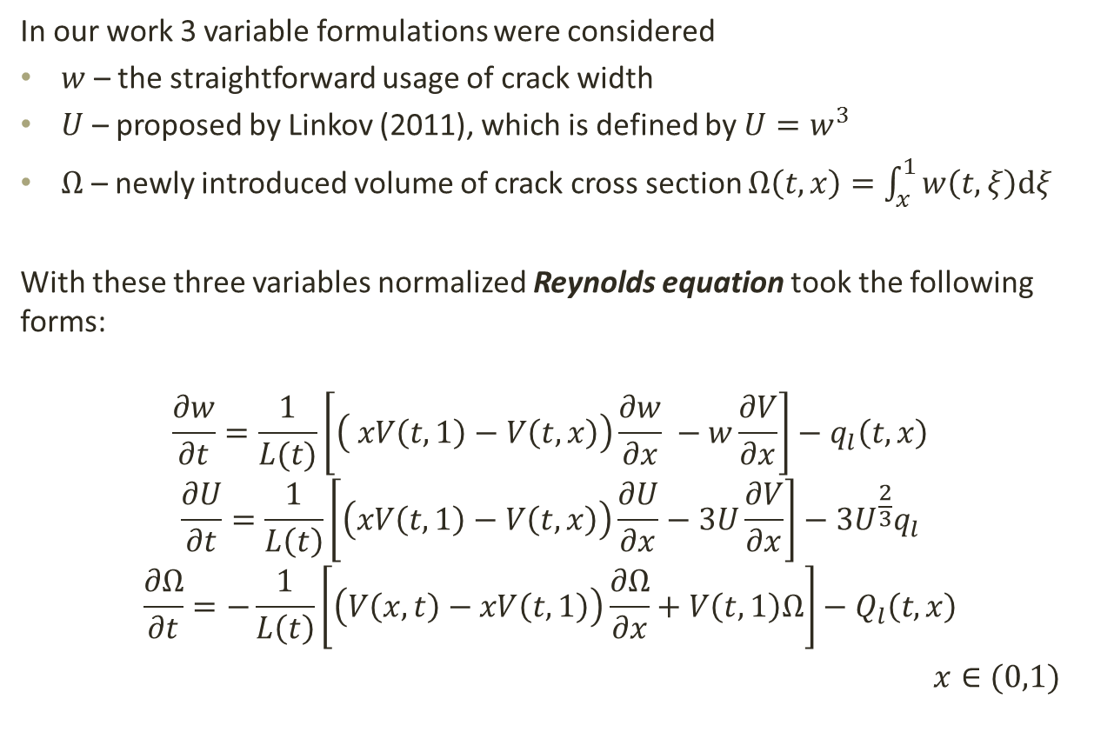
Normalized formulation in different variables
In our work 3 variable formulations were considered
$w$ – the straightforward usage of crack width
$U$ – proposed by Linkov (2011), which is defined by $U=w^{3}$
$Ω$ – newly introduced volume of crack cross section $Ω\left(t,x\right)=\int_{x}^{1}{w\left(t,ξ\right)dξ}$
With these three variables normalized Reynolds equation took the following forms:
$$\frac{∂w}{∂t}=\frac{1}{L(t)}\left[\left( xV\left(t,1\right)−V\left(t,x\right)\right)\frac{∂w}{∂x} −w\frac{∂V}{∂x}\right]−q_{l}\left(t,x\right)$$
$$\frac{∂U}{∂t}=\frac{1}{L\left(t\right)}\left[\left(xV\left(t,1\right)−V\left(t,x\right)\right)\frac{∂U}{∂x}−3U\frac{∂V}{∂x}\right]−3U^{\frac{2}{3}}q_{l}$$
$$\frac{∂Ω}{∂t}=−\frac{1}{L\left(t\right)}\left[\left(V\left(x,t\right)−xV\left(t,1\right)\right)\frac{∂Ω}{∂x}+V\left(t,1\right)Ω\right]−Q_{l}\left(t,x\right)$$
$x∈(0,1)$
Degenerative at crack tip

Slide 9
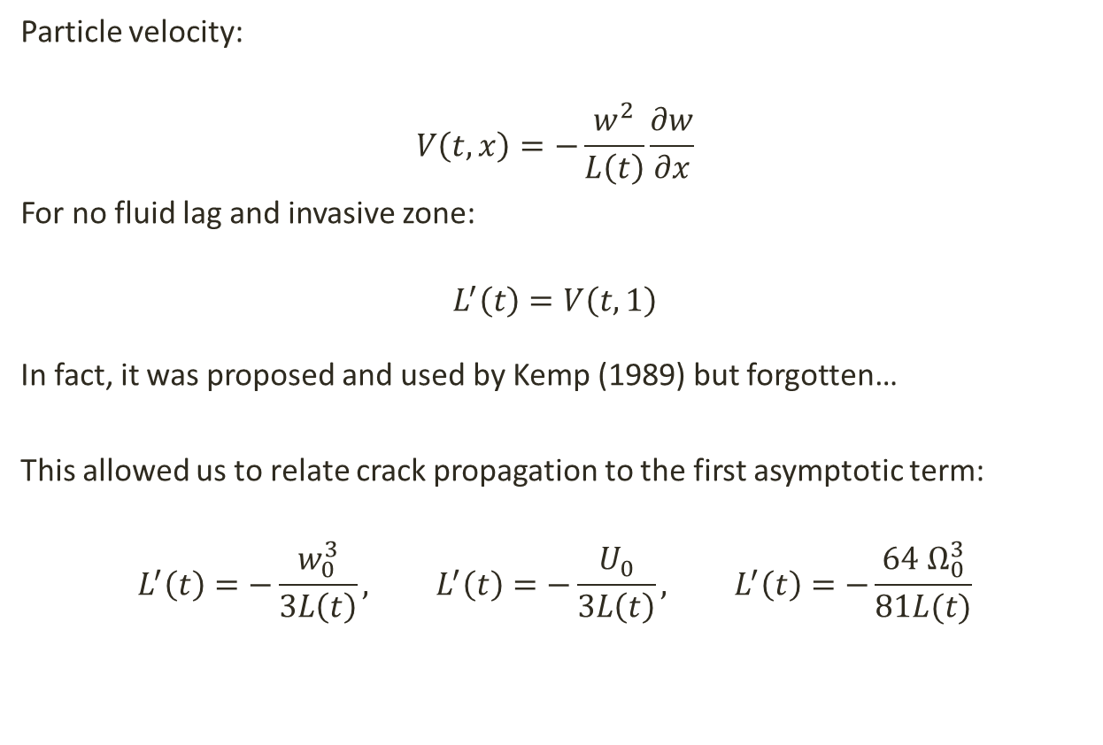
Speed Equation
Particle velocity:
$$V\left(t,x\right)=−\frac{w^{2}}{L\left(t\right)}\frac{∂w}{∂x}$$
For no fluid lag and invasive zone:
$$L^{′}\left(t\right)=V\left(t,1\right)$$
In fact, it was proposed and used by Kemp (1989) but forgotten…
This allowed us to relate crack propagation to the first asymptotic term:
$$L^{′}\left(t\right)=−\frac{w_{0}^{3}}{3L\left(t\right)}, L^{′}\left(t\right)=−\frac{U_{0}}{3L\left(t\right)}, L^{′}\left(t\right)=−\frac{64 Ω_{0}^{3}}{81L(t)}$$

Slide 10
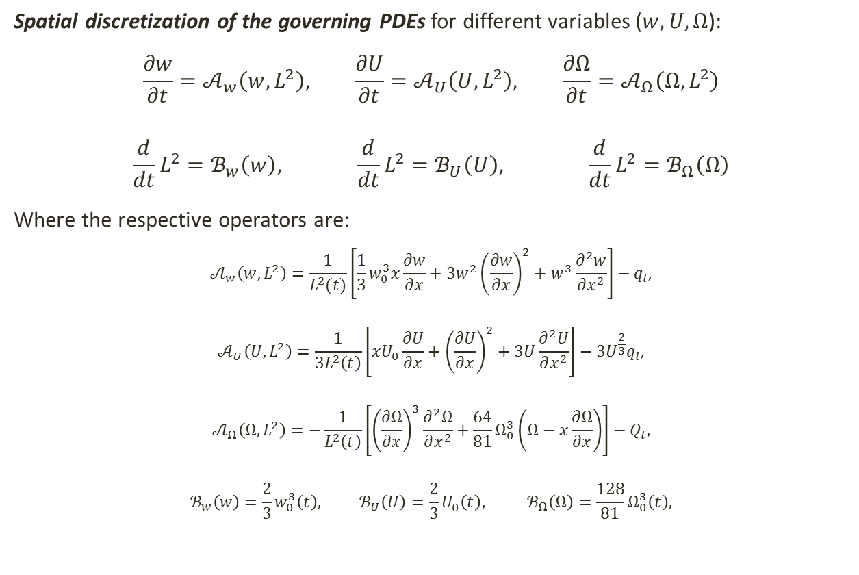
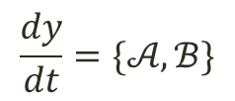
Dynamic Systems for the problem
Spatial discretization of the governing PDEs for different variables ($w, U, Ω$):
$$\frac{∂w}{∂t}=𝒜_{w}\left(w,L^{2}\right), \frac{∂U}{∂t}=𝒜_{U}\left(U,L^{2}\right), {\frac{∂Ω}{∂t}=𝒜}_{Ω}\left(Ω,L^{2}\right)$$
$$\frac{d}{dt}L^{2}=ℬ_{w}\left(w\right), \frac{d}{dt}L^{2}=ℬ_{U}\left(U\right), {\frac{d}{dt}L^{2}=ℬ}_{Ω}\left(Ω\right)$$
Where the respective operators are:
$$𝒜_{w}\left(w,L^{2}\right)=\frac{1}{L^{2}(t)}\left[\frac{1}{3}w_{0}^{3}x\frac{∂w}{∂x}+3w^{2}{\left(\frac{∂w}{∂x}\right)}^{2}+w^{3}\frac{∂^{2}w}{∂x^{2}}\right]−q_{l},$$
$$𝒜_{U}\left(U,L^{2}\right)=\frac{1}{3L^{2}\left(t\right)}\left[xU_{0}\frac{∂U}{∂x}+{\left(\frac{∂U}{∂x}\right)}^{2}+3U\frac{∂^{2}U}{∂x^{2}}\right]−3U^{\frac{2}{3}}q_{l},$$
$$𝒜_{Ω}\left(Ω,L^{2}\right)=−\frac{1}{L^{2}\left(t\right)}\left[{\left(\frac{∂Ω}{∂x}\right)}^{3}\frac{∂^{2}Ω}{∂x^{2}}+\frac{64}{81}Ω_{0}^{3}\left(Ω−x\frac{∂Ω}{∂x}\right)\right]−Q_{l},$$
$$ℬ_{w}\left(w\right)=\frac{2}{3}w_{0}^{3}\left(t\right), ℬ_{U}\left(U\right)=\frac{2}{3}U_{0}^{}\left(t\right), ℬ_{Ω}\left(Ω\right)=\frac{128}{81}Ω_{0}^{3}\left(t\right),$$
This were then solved using MATLAB ODE15s solver for stiff problem, supplied with:
$$\frac{dy}{dt}=\{𝒜,ℬ\}$$

Slide 11
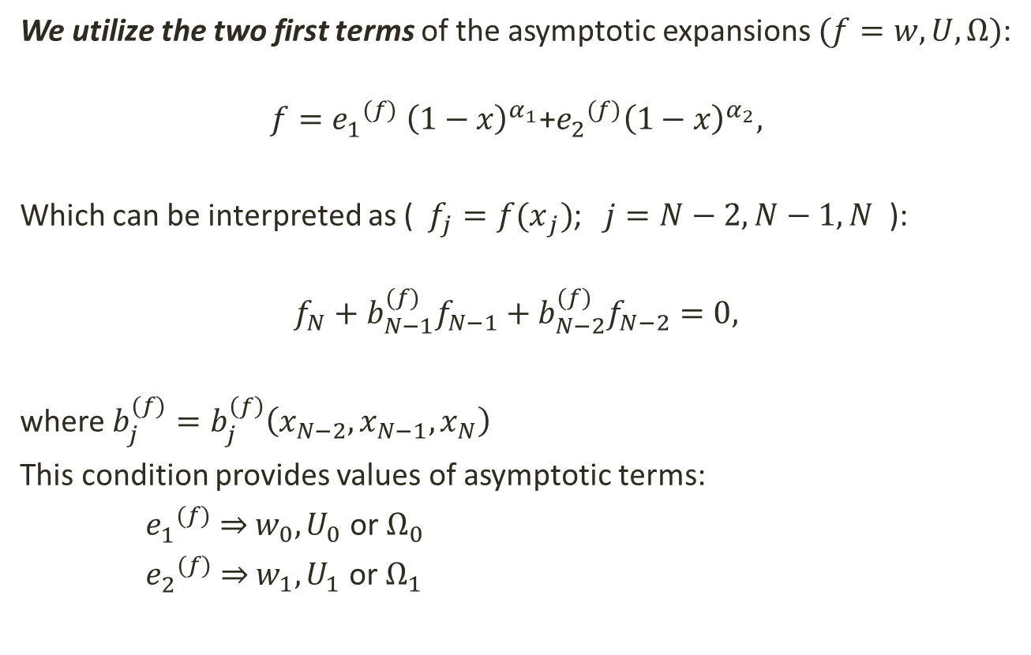
Regularized boundary condition
We utilize the two first terms of the asymptotic expansions $(f=w,U,Ω)$:
$$f={e_{1}^{}}^{(f)} {\left(1−x\right)}^{α_{1}}\text{+}{e_{2}^{}}^{(f)}{\left(1−x\right)}^{α_{2}},$$
Which can be interpreted as (${f_{j}=f(x}_{j})$; $j=N−2,N−1,N$ ):
$$f_{N}+b_{N−1}^{(f)}f_{N−1}+b_{N−2}^{(f)}f_{N−2}=0,$$
where $b_{j}^{(f)}=b_{j}^{\left(f\right)}\left(x_{N−2},x_{N−1},x_{N}\right)$
This condition provides values of asymptotic terms:
${e_{1}^{}}^{(f)}$ ⇒ $w_{0},U_{0}$ or $Ω_{0}$
${e_{2}^{}}^{(f)}$ ⇒ $w_{1},U_{1}$ or $Ω_{1}$

Slide 12
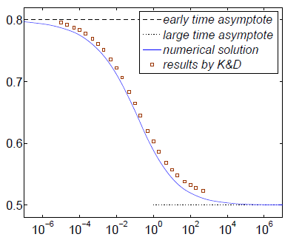
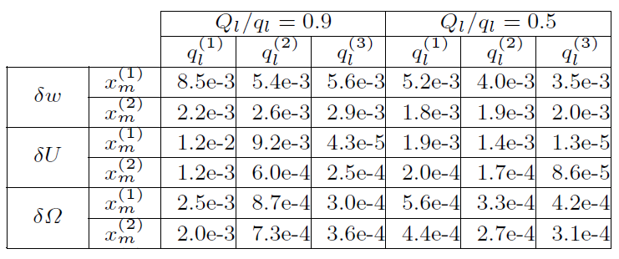
What conclusions do we obtained form these work ?
The modified formulation in DS approach is very effective for single fracture case.
Using two asymptotic terms gives significant accuracy improvements.
Problem stiffness was confirmed and reflected in choice of ODE solvers.
New independent variable, Ω, was proved to be effective in computations
Extended work on Carter Law and its applicability was done.
Our results were compared with the literature (Kovalyshen (2009))
The normalized crack propagation speed
P. Kusmierczyk, G. Mishuris , M. Wrobel (2013) Remarks on application of different variables for the PKN model of hydrofracturing: various ﬂuid-ﬂow regimes. Int J Fract 184:185–213

Slide 13
Testing and further improvements to our model
Preparing for its application in multifracturing

Slide 14
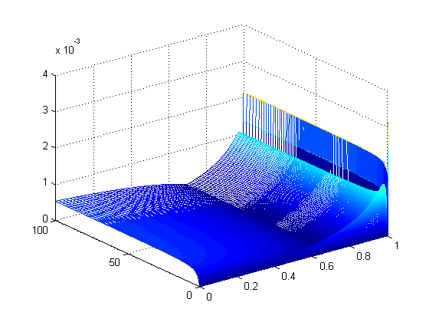
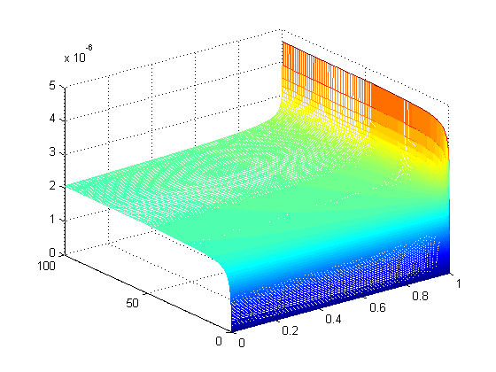
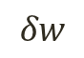
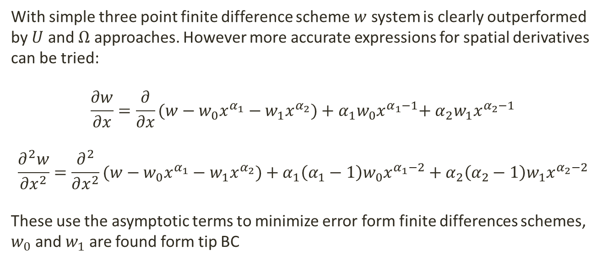
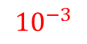
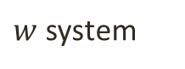
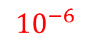
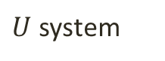
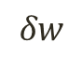
Improved FD scheme
$w$ system
$U$ system
$${10}^{−3}$$
$${10}^{−6}$$
$$δw$$
$$δw$$
With simple three point finite difference scheme $w$ system is clearly outperformed by $U$ and $Ω$ approaches. However more accurate expressions for spatial derivatives can be tried:
$$\frac{∂w}{∂x}=\frac{∂}{∂x}(w−w_{0}x^{α_{1}}−w_{1}x^{α_{2}})+α_{1}w_{0}x^{α_{1}−1}\text{+ }α_{2}w_{1}x^{α_{2}−1}$$
$$\frac{∂^{2}w}{∂x^{2}}=\frac{∂^{2}}{∂x^{2}}(w−w_{0}x^{α_{1}}−w_{1}x^{α_{2}})+α_{1}\left(α_{1}−1\right){w_{0}x}^{α_{1}−2}\text{ + }α_{2}\left(α_{2}−1\right)w_{1}x^{α_{2}−2}$$
These use the asymptotic terms to minimize error form finite differences schemes, $w_{0}$ and $w_{1}$ are found form tip BC
FD
asymptotics

Slide 15
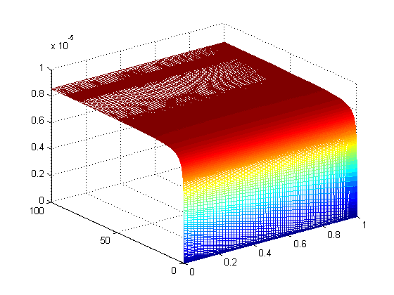
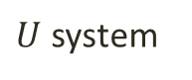
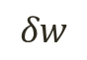
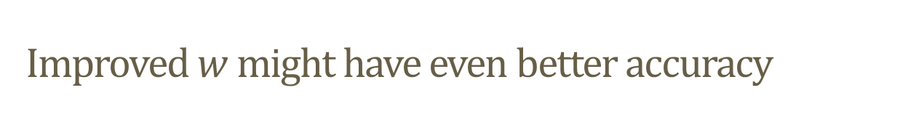
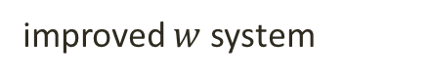
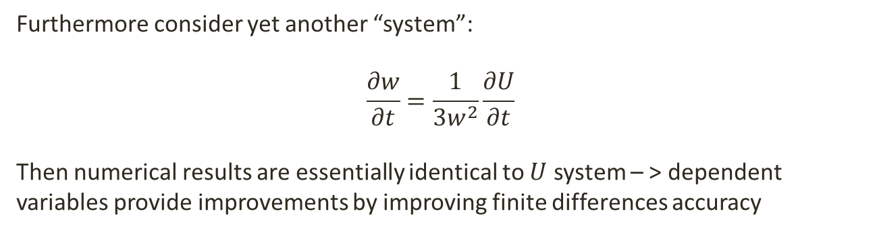


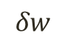
Improved $w$ might have even better accuracy
$$max⁡(δw)={8∗10}^{−6}$$
$$max⁡(δw)={5∗10}^{−6}$$
$$δw$$
$$δw$$
improved $w$ system
$U$ system
Furthermore consider yet another “system”:
$$\frac{∂w}{∂t}=\frac{1}{3w^{2}}\frac{∂U}{∂t}$$
Then numerical results are essentially identical to $U$ system – > dependent variables provide improvements by improving finite differences accuracy

Slide 16
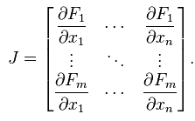
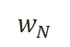
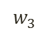
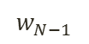
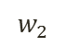
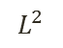
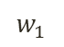
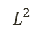
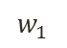
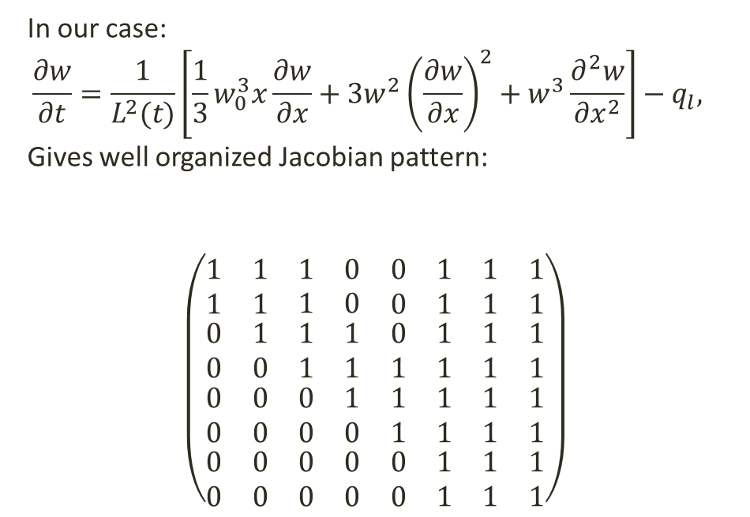


Jacobian pattern
An important advantage of improved FD formulation is that this does not affect the pattern of system Jacobian matrix.
In our case:
$$\frac{∂w}{∂t}=\frac{1}{L^{2}(t)}\left[\frac{1}{3}w_{0}^{3}x\frac{∂w}{∂x}+3w^{2}{\left(\frac{∂w}{∂x}\right)}^{2}+w^{3}\frac{∂^{2}w}{∂x^{2}}\right]−q_{l},$$
Gives well organized Jacobian pattern:
$$\left(\begin{aligned} \\ \begin{matrix}\begin{matrix}\begin{matrix}1 & 1 \\ 1 & 1\end{matrix} & \begin{matrix}1 & 0 \\ 1 & 0\end{matrix} \\ \begin{matrix}0 & 1 \\ 0 & 0\end{matrix} & \begin{matrix}1 & 1 \\ 1 & 1\end{matrix}\end{matrix} & \begin{matrix}\begin{matrix}0 & 1 \\ 0 & 1\end{matrix} & \begin{matrix}1 & 1 \\ 1 & 1\end{matrix} \\ \begin{matrix}0 & 1 \\ 1 & 1\end{matrix} & \begin{matrix}1 & 1 \\ 1 & 1\end{matrix}\end{matrix} \\ \begin{matrix}\begin{matrix}0 & 0 \\ 0 & 0\end{matrix} & \begin{matrix}0 & 1 \\ 0 & 0\end{matrix} \\ \begin{matrix}0 & 0 \\ 0 & 0\end{matrix} & \begin{matrix}0 & 0 \\ 0 & 0\end{matrix}\end{matrix} & \begin{matrix}\begin{matrix}1 & 1 \\ 1 & 1\end{matrix} & \begin{matrix}1 & 1 \\ 1 & 1\end{matrix} \\ \begin{matrix}0 & 1 \\ 0 & 1\end{matrix} & \begin{matrix}1 & 1 \\ 1 & 1\end{matrix}\end{matrix}\end{matrix}\end{aligned}\right)$$
$$w_{1}$$
$$w_{2}$$
$$w_{3}$$
…
$$w_{N−1}$$
$$w_{N}$$
$$L^{2}$$
$$w_{1}$$
$$w_{2}$$
$$w_{3}$$
…
$$w_{N−1}$$
$$w_{N}$$
$$L^{2}$$
If this pattern is used in ODE15s a great increase of computation speed is achieved

Slide 17
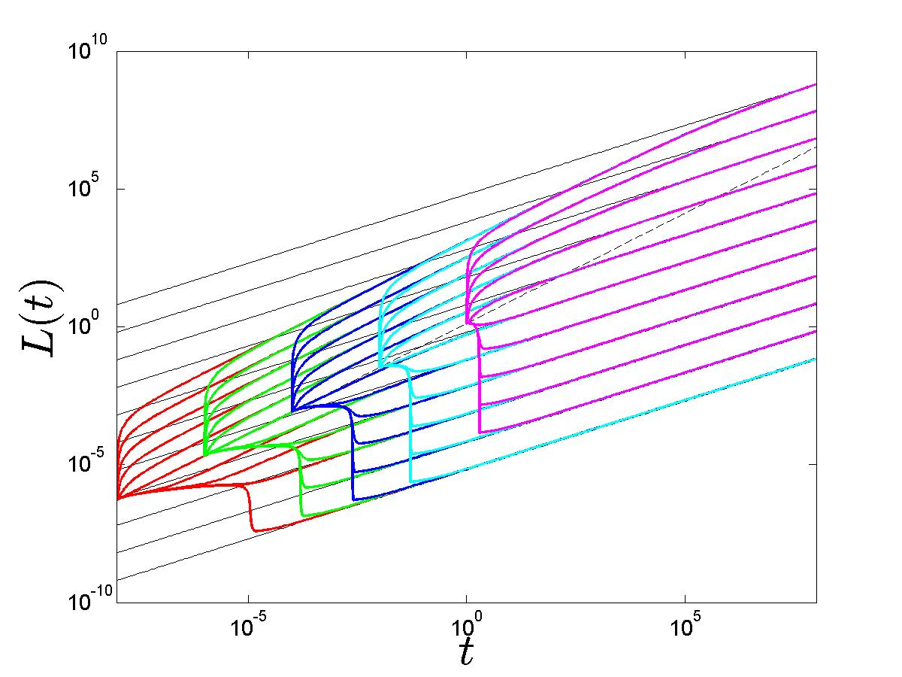
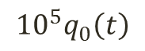
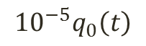
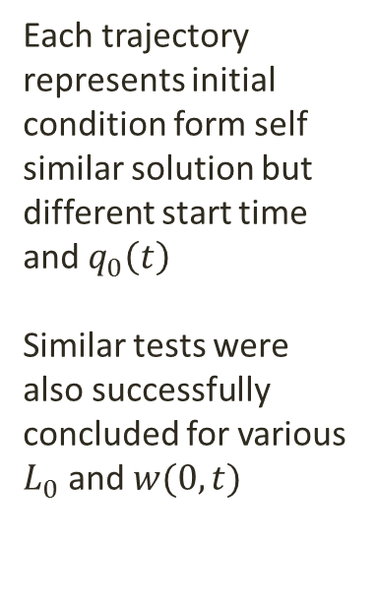
What if different initial conditions are used ?
Each trajectory represents initial condition form self similar solution but different start time and $q_{0}\left(t\right)$
Similar tests were also successfully concluded for various
$L_{0}$ and $w(0,t)$
$${{10}^{5}q}_{0}\left(t\right)$$
$${{10}^{−5}q}_{0}\left(t\right)$$
closing fractures !!!
solver needed to be modified

Slide 18
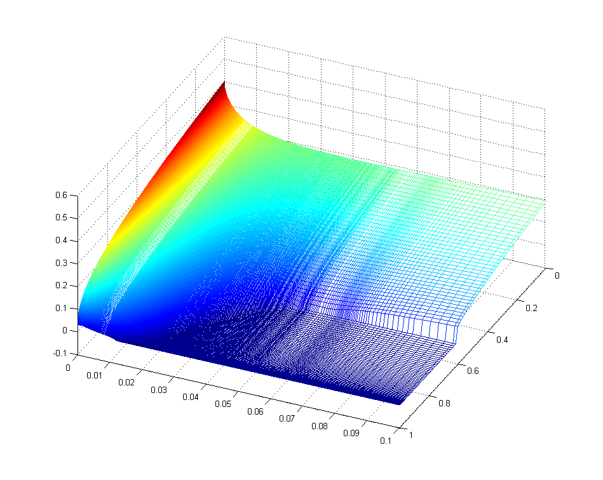
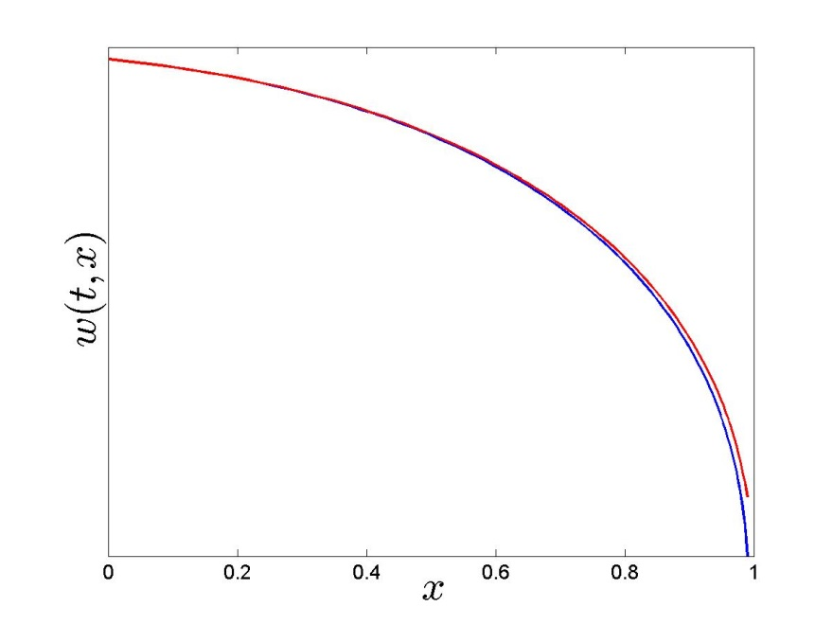
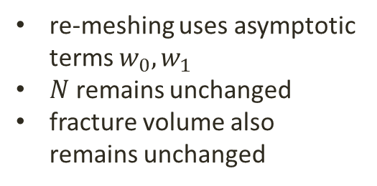




Handling closing fractures, large leak off values
$$w(t,x)$$
$$x$$
$$t$$
The original formulation assumes $\frac{dL}{dt}>0$ and $w\left(t,x\right)>0$, but a work around this limitation is to stop if $w\left(t,x\right)=0$, re-mesh and resume integration with:
$L_{0}=L_{n}\left(1−ε\right)$
re-meshing uses asymptotic terms $w_{0},w_{1}$
$N$ remains unchanged
fracture volume also remains unchanged

Slide 19



How to deal with Carter Law
Unfortunately it is still ambiguous how $τ(x)$ should be interpreted especially for a closing fracture that reopens. Extra algorithm for calculating exposure time $t−τ(x)$ is used.

Slide 20




Handling closing fractures, negative pumping
Now consider fixed amount of fluid that gets pumped in and out:
$q_{0}=\sin\left(t\right)$
Total volume pumped in
Extra volume appeared from nowhere, fluid balance must be monitored
At some point everything goes wrong…
Relative fluid balance in fracture

Slide 21

What do we learn from these extra tests ?
Our model is very flexible (every parameter can be played with)
There is relatively large range of possible initial condition values ($q_{0}, w\left(0, x\right),L_{0}$), but outside that range computations will fail.
Model can be to some extend modified to handle closing fractures, it is possible to stop, re-mesh and resume.
While model might brake, the fluid balance can check if our result are still valid
Dependent variables are useful for spatial discretization, but provide no apparent benefit for integration
With experience the next task can be handled.

Slide 22
Building Multifracturing Model

Slide 23



What is “Multifracturing” ?

Slide 24


What do I mean by “Multifracturing”
Well, $q_{0}$ is applied here
existing closed crack
PKN like crack
Solid concrete pipe
PKN like “pipe”
Junction

Slide 25


PKN “Pipe” , Junctions and concrete pipes
PKN pipes are straightforward :
$$\frac{∂w}{∂t}=\frac{1}{L^{2}(t)}\left[\frac{1}{3}w_{0}^{3}x\frac{∂w}{∂x}+3w^{2}{\left(\frac{∂w}{∂x}\right)}^{2}+w^{3}\frac{∂^{2}w}{∂x^{2}}\right]−q_{l}=𝒞_{w}\left(w,L^{2}\right),$$
Junctions are based on two assumptions, given $n$ connected elements, pressure at a junction is the same for all of them:
$$p_{1}=p_{2}= …=p_{n}$$
Sum of all the flow in and out of a junction is zero (zero flux sum):
$$q_{1}+q_{2}+ …+q_{n}=0$$
Concrete pipe segments can be tackled directly by Poiseuille Law (laminar flow in a pipe)
$$q=\frac{ΔpπR^{4}}{8μL}$$

Slide 26








How to make it stick together ?
$$ℬ$$
$𝒜$ - change of fracture width
$ℬ$ - change of fracture length
Lets also consider two extra operators:
$𝒞$ - change of “PKN pipe” width
$𝒟$ - fluid lost in a segment
$L(t)\int_{0}^{1}{q_{l}dx}$
(used for error checking)
$$𝒜$$
$$𝒟$$
$$𝒞$$
$$𝒟$$
Previously for a single fracture ODE solver was given:
$$\frac{dy}{dt}=\{𝒜,ℬ\}$$
Now given a problem with $n$ fractures and $m$ pipes:
$$\frac{dy}{dt}=\{𝒜^{\left(1\right)},ℬ^{\left(1\right)},𝒜^{\left(2\right)},ℬ^{\left(2\right)},…,𝒜^{\left(n\right)},ℬ^{\left(n\right)},$$
$$𝒞^{\left(1\right)},𝒞^{(2)},…,𝒞^{\left(m\right)}, 𝒟^{\left(1\right)},𝒟^{\left(2\right)},…,𝒟^{\left(m+n\right)}\}$$

Slide 27



How to make it stick together ?
Object Orientated design is used where:
Model holds all cracks, junctions and pipes
Each element holds its characteristics internally (width, length, direction, grid)
Cracks and Pipes compute their ODE, but scheme can be changed ($w,U,Ω$)
Model combines ODE from Cracks and Pipes into one large vector
Essentially any stiff ODE solver can be used (ODE15s and LSODE)
1..2
The geometry is actually a graph with junctions being nodes and pipes and cracks serving as edges
This task would be too painful to do in MATLAB, the code is written mostly in JAVA

Slide 28



How to apply BC to pipe and crack segments ?
We can split a benchmark solution into a pipe and crack segment.
benchmark fracture
pipe segment
crack segment

Slide 29





How to apply BC to pipe and crack segments ?
Since flow is related to pressure by:
$q=\frac{1}{MLk^{3}}p^{3}\frac{∂p}{∂x}$
A general scheme that uses newton method to find pressure can be constructed:
$$\sum_{j=1}^{m}{α_{j}p^{4}}+\sum_{j=1}^{m}{β_{j}p^{3}+}\sum_{k=1}^{l}{γ_{k}p}−\sum_{k=1}^{l}{γ_{k}{p_{other}^{}}^{\left(k\right)}}+q_{0}=0$$
Where $m$ is the number of connected crack or crack pipe segments, $l$ is the number of connected concrete pipes, $p_{other}^{}$ is the pressure at other junctions connected by solid pipe segments. An approximation $\frac{∂p}{∂x}=αp+β$ is used. Pumping can be applied by adding $q_{0}$.
This scheme can be tested on spited benchmark to obtain unchanged accuracy:
$${10}^{−4}$$
$${10}^{−3}$$

Slide 30





How well does it work so far ?
There are no restriction on what structures can be made:
relative fluid balance stable around ${10}^{−3}$

Slide 31


Crack collisions and splits
As fractures propagate they might intersect with other fractures.
Possible scenarios and outcomes are:
crack to crack collision => crack and 2 pipe segments
crack to pipe collision => 3 pipe segments
crack to closed crack => 2 cracks and pipe segment
crack to junction => pipe segment
crack to crack collision at crack tip=> very rare
What happens when fractures collide does not directly influence the computations. Our model stops, remeshes and then resumes.

Slide 32



Crack collisions and splits
What is important is to maintain continuity:
Fluid balance must remain the same
New segment values must be extrapolated,
as new grid points are added
Ignore tiny mass transfers, go back in time
to avoid large ones
Newly added segment should be adjusted so the solver
can handle new problem
relative fluid balance still stable around ${10}^{−3}$

Slide 33





Elastic interaction between fractures
Originally PKN model considered $p$ as the net fluid pressure defined as:
$p_{net}=p_{fluid}−σ_{0}$
Where $σ_{0}$ is the uniform back stress. However an additional term $σ_{l}$ , effect form other neighboring fractures should also be considered:
$p_{net}=p_{fluid}−σ_{0}−σ_{l}$
This is still work in progress, but so far some analytical results from Bunger(2013) successfully were followed.
$$L(t)$$
$$t$$

Slide 34



Ongoing and future challenges:
Full implementation of elastic interactions
Computational optimization (this might include: parallelization, proper custom jacobian function, variable grid sizes, deeper ODE solver integration)
Better failsafe mechanisms, possible integration of closing fractures to the model
Finalization of coding and preparation for “open source release”
Publication of two articles, one on initial conditions and the other one on multifracturing
And finally finishing PhD thesis
The End
Fluid balance approaches ${10}^{−3}$

